Slide 1
Linked List outline
Why linked lists
Linked lists
Representation of Linked lists in memory
Traversing a linked lists
Basic operations of linked lists
  Insert, find, delete, print, etc.
Variations of linked lists
  Circular linked lists
  Doubly linked lists

Slide 2
Why linked lists
Disadvantages of arrays as storage data structures:
  slow insertion in ordered array
  Fixed size
Linked lists solve some of these problems
Linked lists are general purpose storage data structures.

Slide 3
Disadvantages of Arrays
The size of the array is fixed.
  In case of dynamically resizing the array from size S to 2S, we need 3S units of available memory.
  Programmers allocate arrays which seem "large enough” This strategy has two disadvantages: (a) most of the time there are just 20% or 30% elements in the array and 70% of the space in the array really is wasted. (b) If the program ever needs to process more than the declared size, the code breaks.
Inserting (and deleting) elements into the middle of the array is potentially expensive because existing elements need to be shifted over to make room
CENG 213 Data Structures

Slide 4
Linked lists
Linked lists are appropriate when the number of data elements to be represented in the data structure at once is unpredictable.
Linked lists are dynamic, so the length of a list can increase or decrease as necessary.
Each node does not necessarily follow the previous one physically in the memory.
Linked lists can be maintained in sorted order by inserting or deleting an element at the proper point in the list.
CENG 213 Data Structures

Slide 5
Linked lists
  A linked list, or one way list, is a linear collection of data elements, called nodes, where the linear order is given by means of pointers.
  Each node is divided into two parts:
  The first part contains the information of the element, and
  The second part, called the link field or next pointer field, contains the address of the next node in the list.
struct node
{
char data;
struct node *next;
};
node
A
data
pointer

Slide 6
The pointer of the last node contains a special value, called the NULL pointer. A pointer variable – called START which contains the address of the first node.
  A special case is the list that has no nodes, such a list is called the null list or empty list and is denoted by the null pointer in the variable START.
Start
node
node
node
Data
Next
Data
Next
Data
Linked list with 3 nodes

Slide 7
linked lists
A linked list organizes a collection of data items (elements ) such that elements can easily be added to and deleted from any position in the list.
Only references To next elements are updated in insertion and deletion operations.
There is no need to copy or move large blocks of data to facilitate insertion and deletion of elements.
Lists grow dynamically.

Slide 8
Creation of linked list
#include<stdio.h>
struct node
{
int data;
struct node *next;
};
struct node *start;
void main()
{
struct node *nn;
int a;
nn=(struct node *) malloc(sizeof(struct node));
printf("enter data:");
scanf("%d",&nn->data);
a=nn->data;
if(start==NULL) //checking if List is empty
{
nn->next=NULL;
start=nn;
}
else
{
nn->next=start;
start=nn;
}
printf("%d succ. inserted\n",a);
return;
}

Slide 9
Traversing a linked lists
LIST be a linked list in memory stored in linear arrays INFO and LINK with START pointing to the first element and NULL indicating the end of LIST.
We want to traverse LIST in order to process each node exactly once.
Pointer variable PTR points to the node that is currently being processed.
LINK[PTR] points to the next node to be processed.
PTR : =LINK[PTR]
PTR
Fig : PTR : = LINK[PTR]
START
INFO LINK
X

Slide 10
Traversing a linked lists
For printing the information at each node of a linked list, must traverse the list.
Algorithm 5.1 : PRINT(INFO, LINK, START)
Algorithm Prints the information at each node of the list.
      Set PTR : =START.
      Repeat steps 3 and 4 while PTR : ≠ NULL:
      Write : INFO[PTR].
      Set PTR : =LINK[PTR].
      Exit.

Slide 11
Finding number of element in a linked lists
For Finding the number NUM of elements in a linked list, must traverse the list.
Algorithm 5.1 : COUNT(INFO, LINK, START, NUM)
      Set NUM: =0.
      . Set PTR : =START.
      Repeat steps 4 and 5 while PTR : ≠ NULL:
      Set NUM : =NUM+1.
      Set PTR : =LINK[PTR].
      Exit.

Slide 12
Traversing a linked lists
void display(void)
{ struct node *temp;
if(start==NULL)
{ printf("sll is empty\n");
return;
}
printf("elements are:\n");
temp=start;
while(temp!=NULL)
{ printf("%d\n",temp->data);
temp=temp->next;
} return;
}

Slide 13
Insertion into a linked list
Node N is to be inserted in to the list between nodes A and B
Two pointer fields are changed as follows:
The next pointer field of node A now points to the new node N
The next pointer field of node N now points to node B, to which node A previously pointed.
START
Node A
Node B
START
(a) Before insertion
Node A
Node B
(b) After insertion
Node N
Node N

Slide 14
Inserting a new node
Possible cases of Insert Node
  Insert into an empty list
  Insert in front
  Insert at end
  Insert in middle

Slide 15
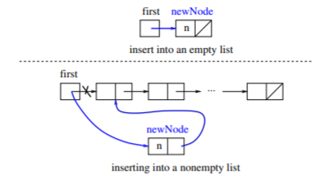
Insertion at the first
Steps:
Create a Node
Set the node data Values
Connect the pointers

Slide 16


Insertion Description
head
48
17
142
//
Follow the previous steps and we get
Step 1
Step 2
Step 3
head
93

Slide 17
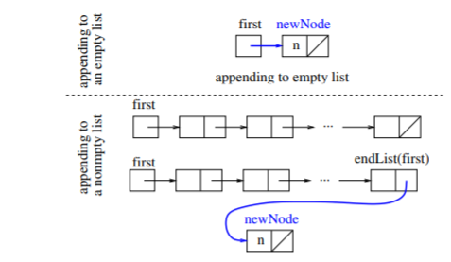
Insertion at the end
Steps:
Create a Node
Set the node data Values
Connect the pointers

Slide 18



Insertion Description:
head
48
17
142
//
Follow the previous steps and we get
Step 1
Step 2
Step 3

Slide 19
Insertion in the middle
Steps:
Create a Node
Set the node data Values
Break pointer connection
Re-connect the pointers

Slide 20




Insertion Description
Step 1
Step 2
Step 3
Step 4

Slide 21
Deleting from the top
Steps
Break the pointer connection
Re-connect the nodes
Delete the node

Slide 22
Deletion Description
head
6
4
17
42
head
6
4
17
42
head
4
17
42

Slide 23
Deleting from the end
Steps
Break the pointer connection
Set previous node pointer to NULL
Delete the node

Slide 24
Deletion Description
head
6
4
17
42
head
6
4
17
42
head
6
4
17

Slide 25
Deleting from the Middle
Steps
Set previous Node pointer to next node
Break Node pointer connection
Delete the node

Slide 26
Deletion Description
head
4
17
42
head
4
17
42
head
4
42

